Slide 1
Tesla’s Safety
Exploring Relationship Between Tesla Vehicles and Road Safety
Project 3 Team 7:
Elsa Figueroa
Ning Ding
Vincent G
Aditi Bindlish

Slide 2
AGENDA
Introduction - Data Source
Unprocessed Data
Identifying Incident Types
Database - ERD
Processing Data - Flask
Visuals

Slide 3
INTRODUCTION – Data Source
Kaggle : Tesla Autonomous Deaths Updated 2023
https://www.kaggle.com/datasets/ibriiee/tesla-autonomous-deaths-data-updated-2023
A dataset of Fatal Incidents Involving Tesla Vehicles
Information on accidents involving Tesla vehicles that have resulted in the death of at least one person
Presence of Autopilot at the time of the crash
Description of Incident
Number of Deaths, by driver, passenger, others
Model of the vehicle involved
Country and State of Accident

Slide 4
Unprocessed Data

Slide 5
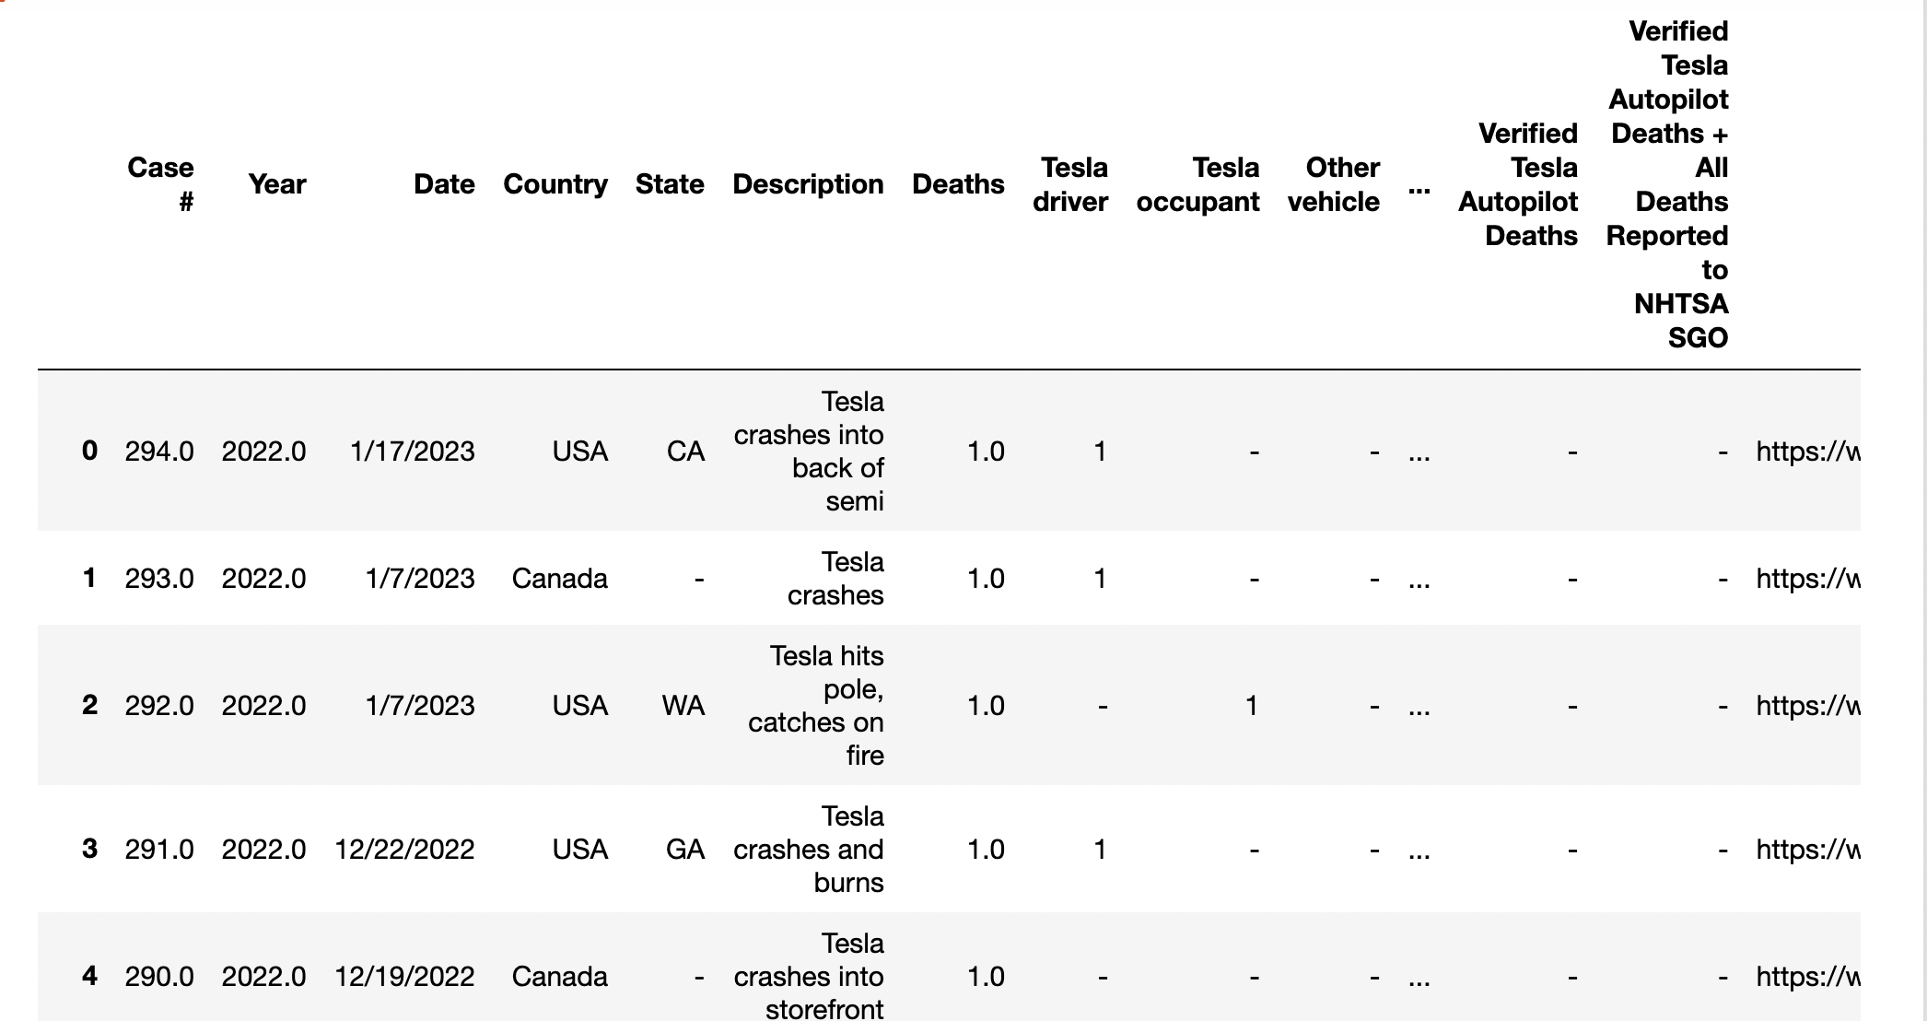

Slide 6
Technologies Used
Python
SQL-Postgres
Flask API
Javascript Plotly

Slide 7
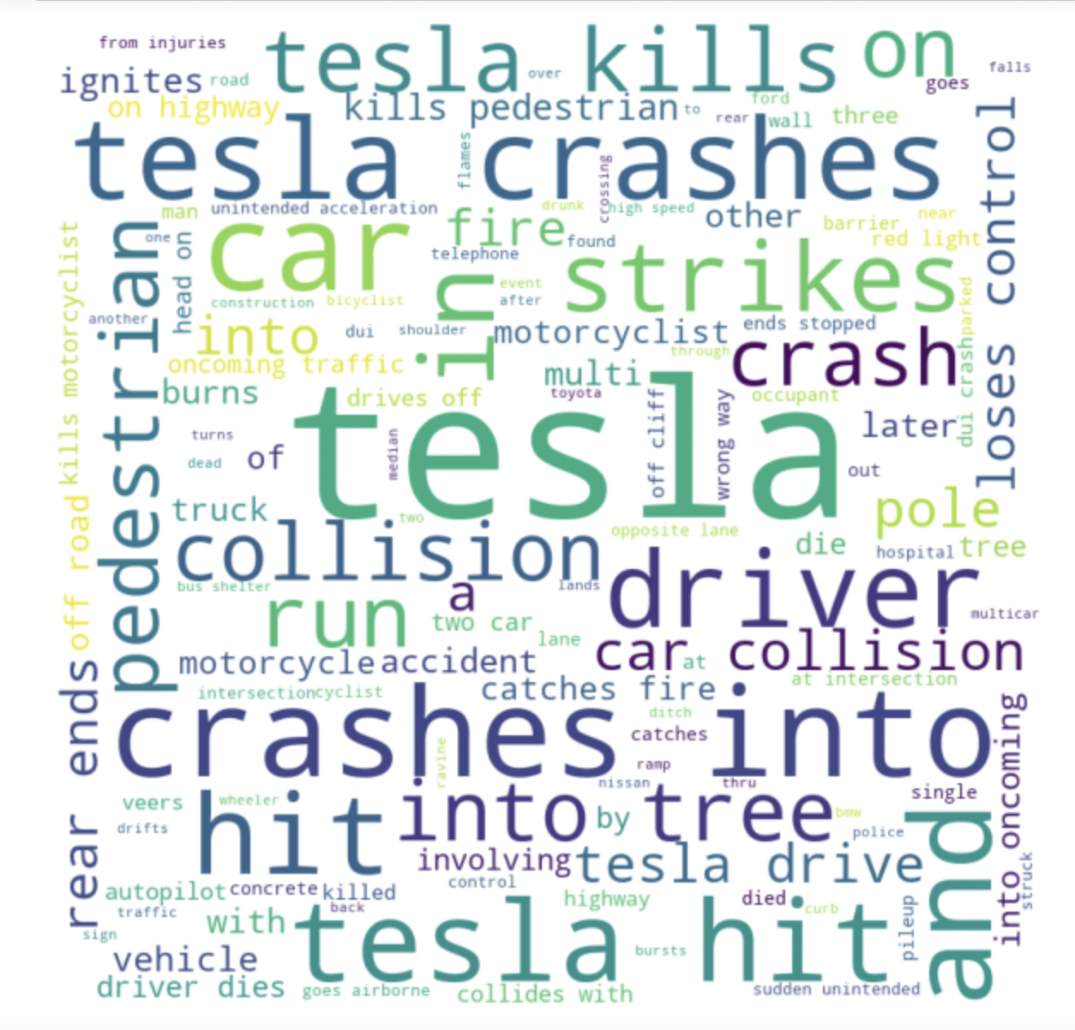
Identifying Incident Types…. Part 1
A simple word cloud did not yield desired results
Repetitive themes did not emerge
Common words like tesla, crash, driver, later, tree repeated as a theme
Library used: wordcloud

Slide 8
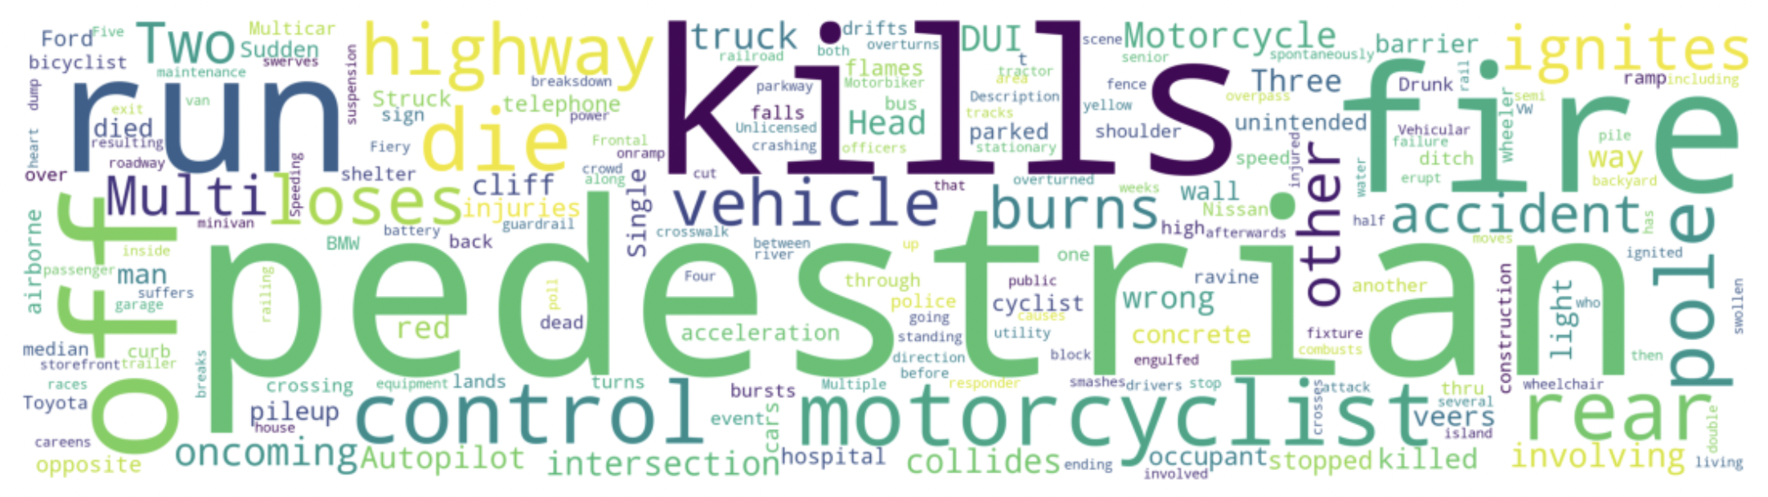
Identifying Incident Types…. Part 2
Added Stopwords to remove common words like tesla, crash, road, tree, driver, hit etc.
Set collocations=False to avoid same kind of text to appear more than once
Results show patterns and trends like:
Fire
Death of pedestrians
Car pile ups
Motocycle involvement
Drink and Drive cases
Vehicle losing control

Slide 9
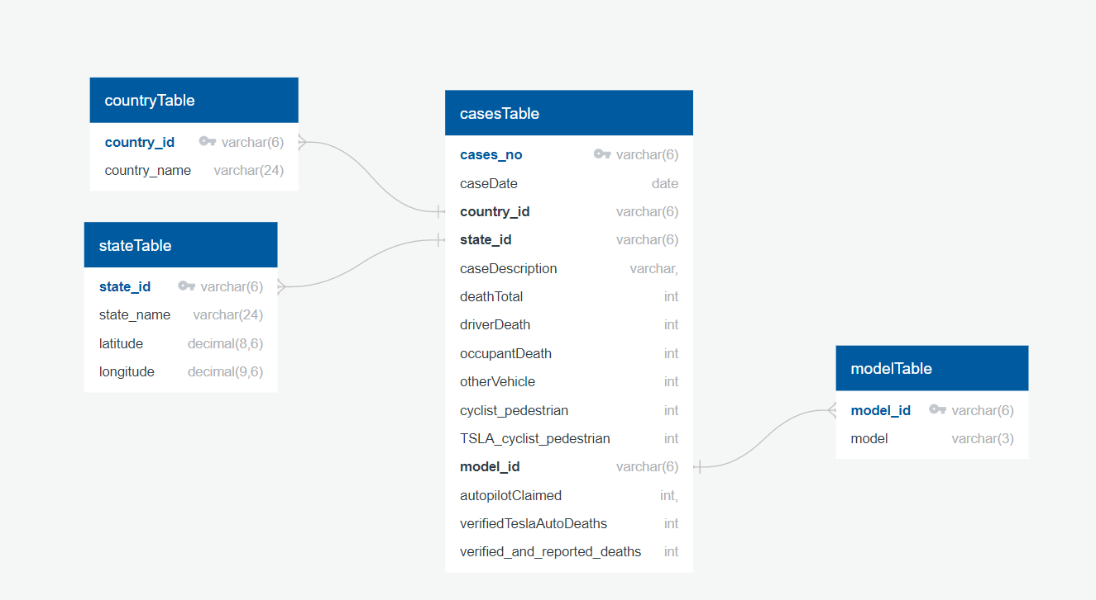
ERD – database in Postgres

Slide 10
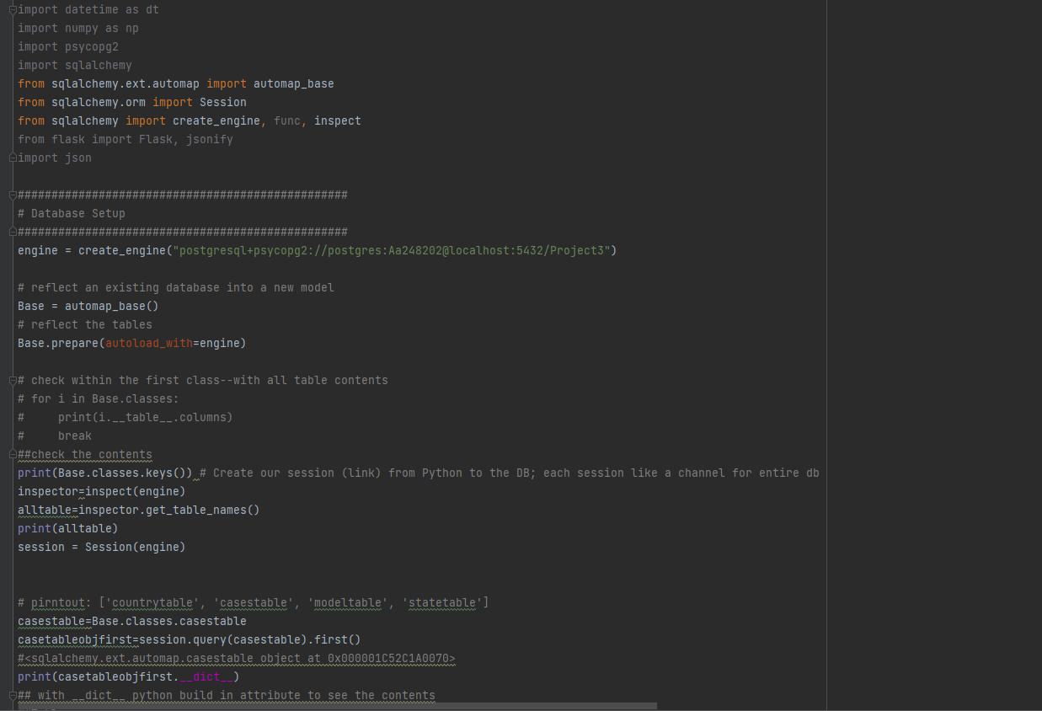
Using Flask to Create Routes and Json files …. Part 1

Slide 11
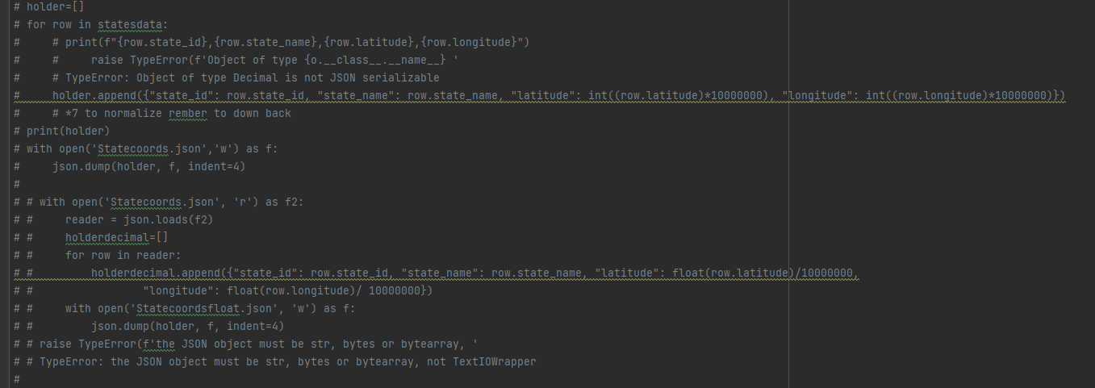
Using Flask to Create Routes and Json files …. Part 2

Slide 12
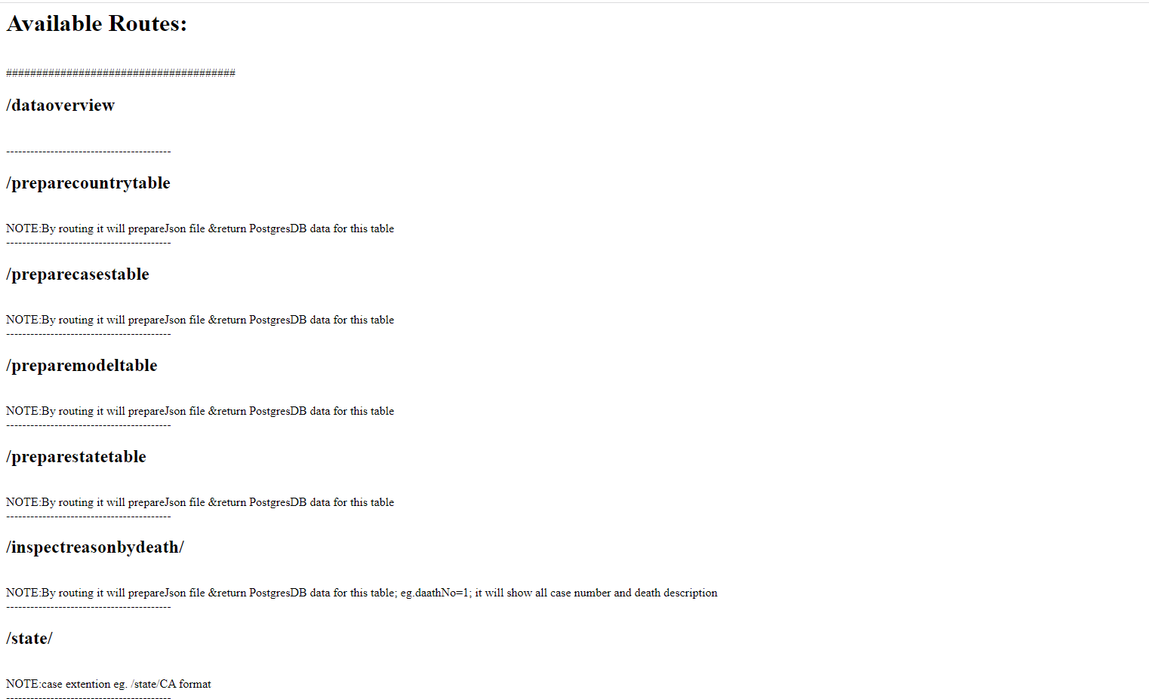
Using Flask to Create Routes and Json files …. Part 3

Slide 13
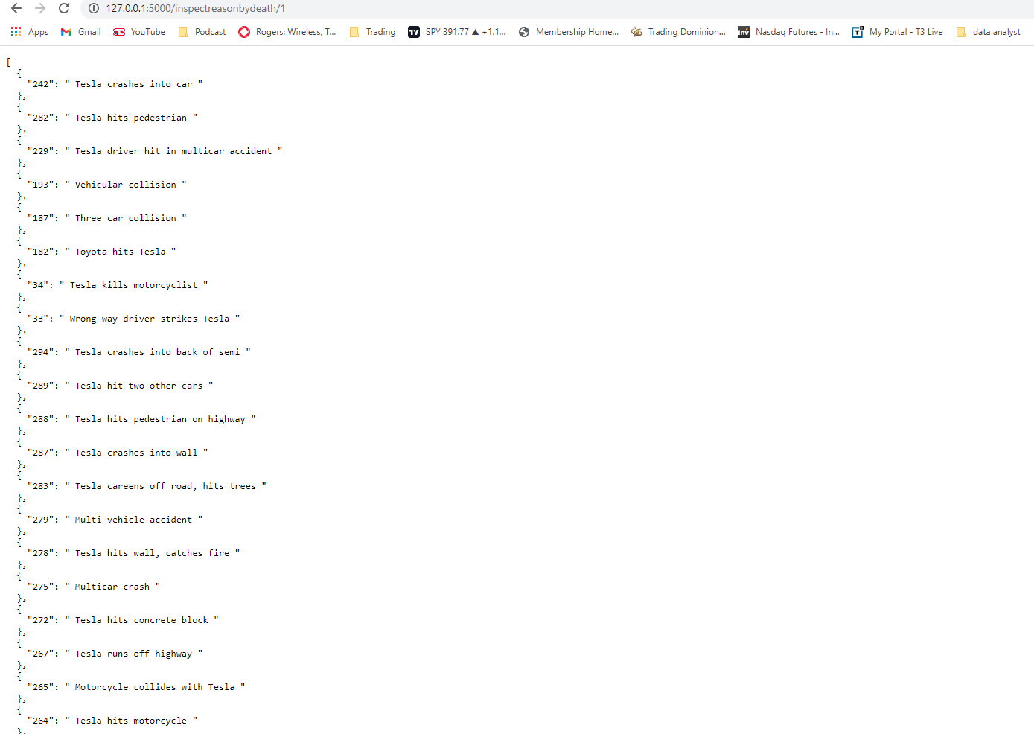
Using Flask to Create Routes and Json files …. Part 4

Slide 14
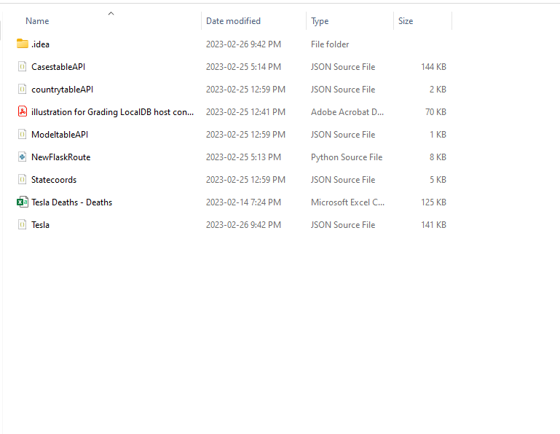
Using Flask to Create Routes and Json files …. Part 5

Slide 15
Visualizations

Slide 16
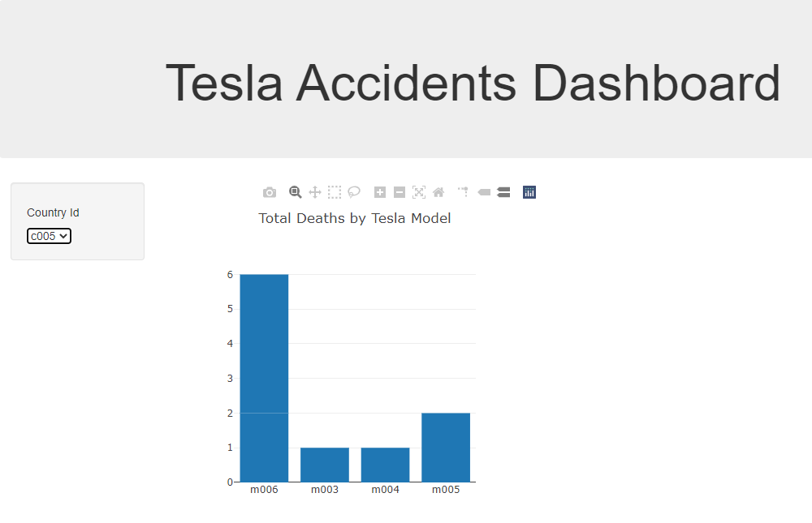

Slide 17
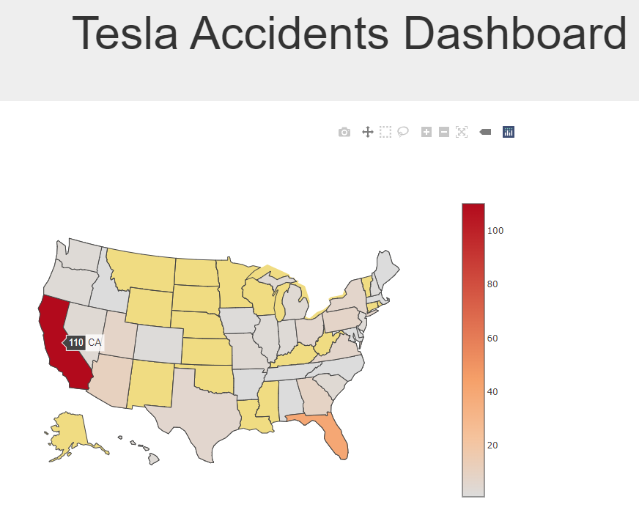

Slide 18
THANK YOU

